Slide 1
Manufactory Test Station Data Extractor for Analyze
Simon He
April 01, 2013

Slide 2
Current Test Software We use
1. Fixture Test Engine
Test DUT’s power & current & power factor at different voltage.
2. Multi-Segment Light Measure
Test DUT’s brightness / color / CCT and power/current, etc. at Assembly level.
3. LED Inspector
Test LED’s color / location / brightness in PCA level
Test LED’s color / location / brightness in Assembly level after burn-in

Slide 3
What we need
Software will generate a report file after testing
But it separate to single file per unit (1000 unit will have 1000 files)
But we want to analyze the test data as a whole, eg. check average brightness, plot the chart for power data, calculate CPK and define the testing limit
We need a tool to extract the data what we need from the results

Slide 4
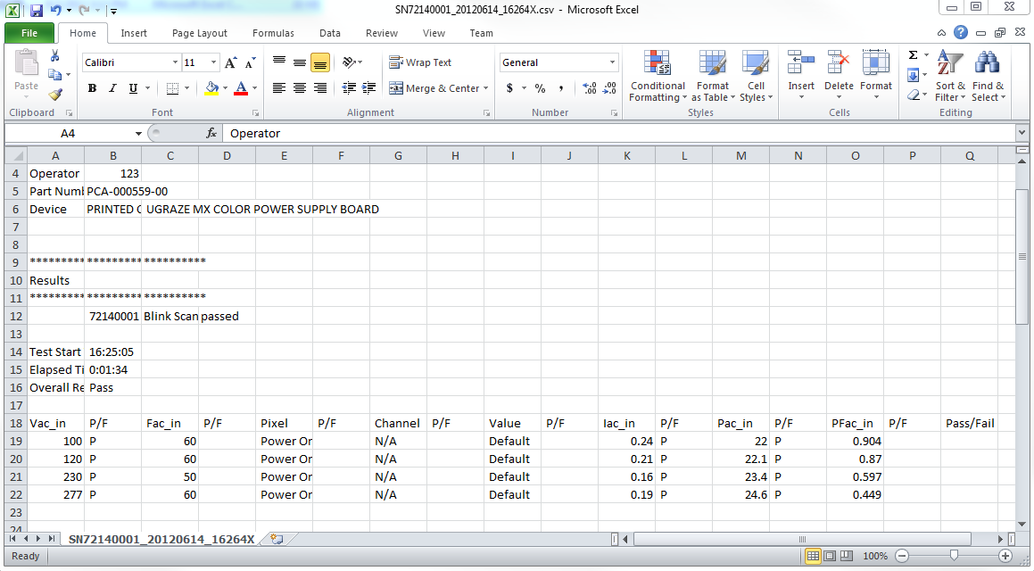
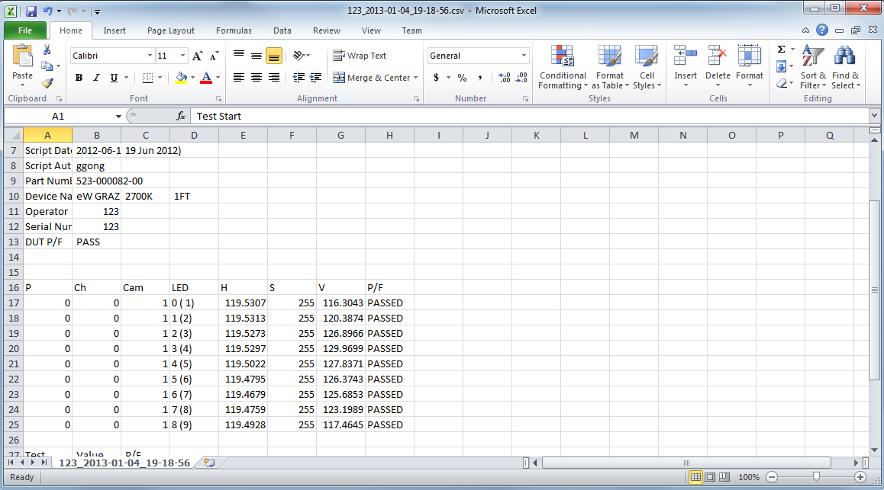
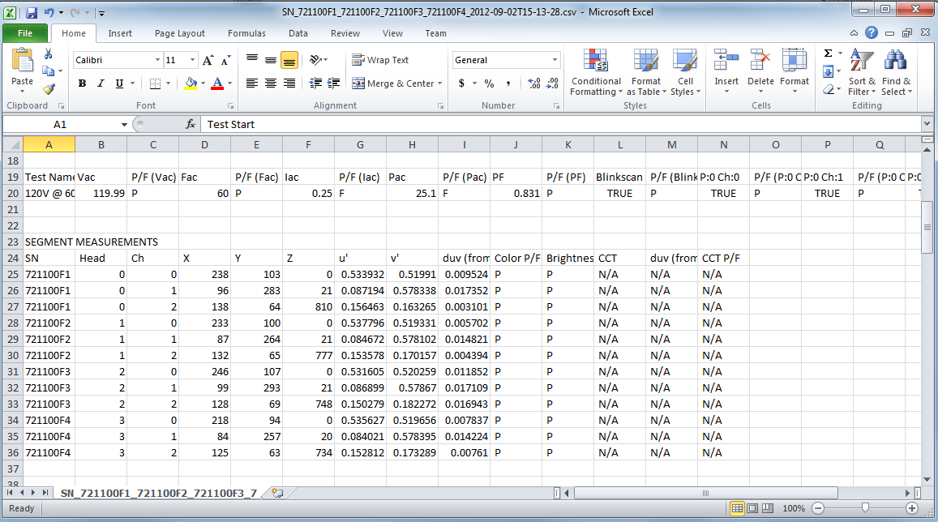
Problems
Different test tool, different product, different Model, even different length have different file format.

Slide 5
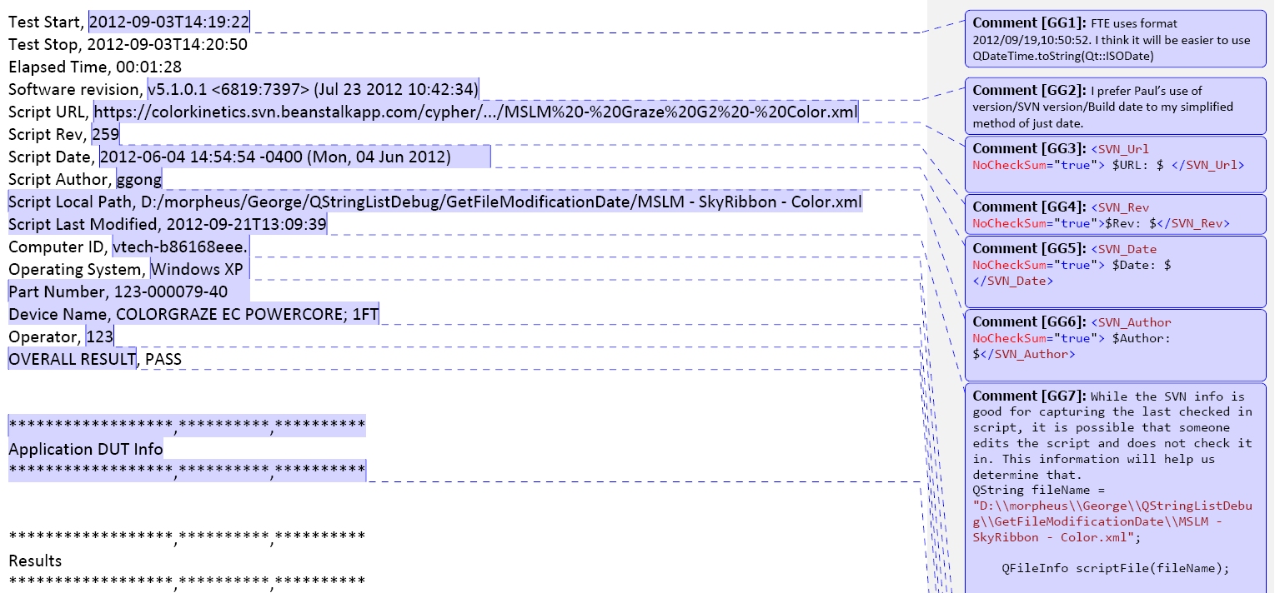
One Solution
The result are CSV file format and can manipulate like xls file
Data structure are similar

Slide 6
One Solution (continue)
Collect the same data (same product, same test station, same model)
Analyze and find the cell location which we are interesting
Write them into a configuration file
Write a program to extract the data based on this configuration file

Slide 7
Write the Program
Several Reasons for Using Python 2.7 to write the program:
It is OOP language
It is free to use (Do not need to buy commercial license)
Easy to learn
Many resource on the web

Slide 8
Software Flow
Select Target Folder
Choose correct Product / Station/ Fixture Type
Parse the config.v file
Extract the data
Generate the xls file

Slide 9
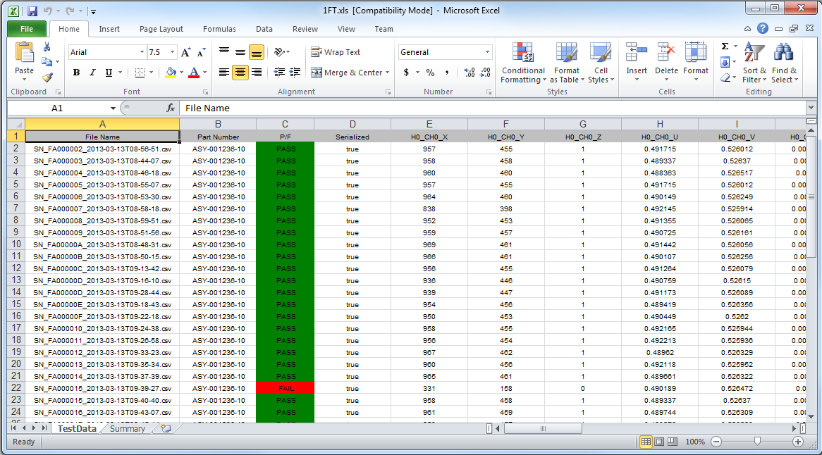
Result

Slide 10
Improvement
config.v is not easy to maintain
UI is not friendly
Lack of data analyze function
Error handling is not considered

